Slide 1
1. Given the following binary tree:
tree
45
38
65
34
41
63
72
16
35
39
44
55
64
(a) What is the inorder traversal of the tree?
=> 16 → 34 → 35 → 38 → 39 → 41 → 44 → 45 → 55 → 63 → 64 → 65 → 72
(b) What is the preorder traversal of the tree?
=> 45 → 38 → 34 → 16 → 35 → 41 → 39 → 44 → 65 → 63 → 55 → 64 → 72
(c) What is the postorder traversal of the tree?
=> 16 → 35 → 34 → 39 → 44 → 41 → 38 → 55 → 64 → 63 → 72 → 65 → 45
What is the height of the tree? What nodes are on level 2?
=> Height = 4 | Nodes in level 2 (root is 0) = 34, 41, 63, 72

Slide 2
2. Given the following binary expression tree:
tree
*
/
+
-
24
-
12
48
%
18
*
7
2
5
2
What is the inorder traversal of the tree?
=> ((48 – (7 % 2)) / 24) * ((18 – ( 5 * 2)) + 12)
(b) What is the postorder traversal of the tree?
=> 48 7 2 % - 24 / 18 5 2 * - 12 + *
What does it evaluate to if using integer division?
=> 20
What does it evaluate to if using float division? 39.1667

Slide 3
The elements in a binary tree area to be stored in an array. Each element is a
nonnegative int value.
a. What value can you use as a dummy value, if the binary tree is not complete? null_
b. Show the contents of the array, given the tree illustrated below
[0]
[1]
[2]
[3]
[4]
[5]
[6]
[7]
[8]
[9]
[10]
[11]
[12]
[13]
[14]
13
tree
73
14
21
7
73
21
null
19
6
7
19
6
null
51
51
45
null
null
null
null
Using 2i + 1 / 2i + 2
null
45

Slide 4
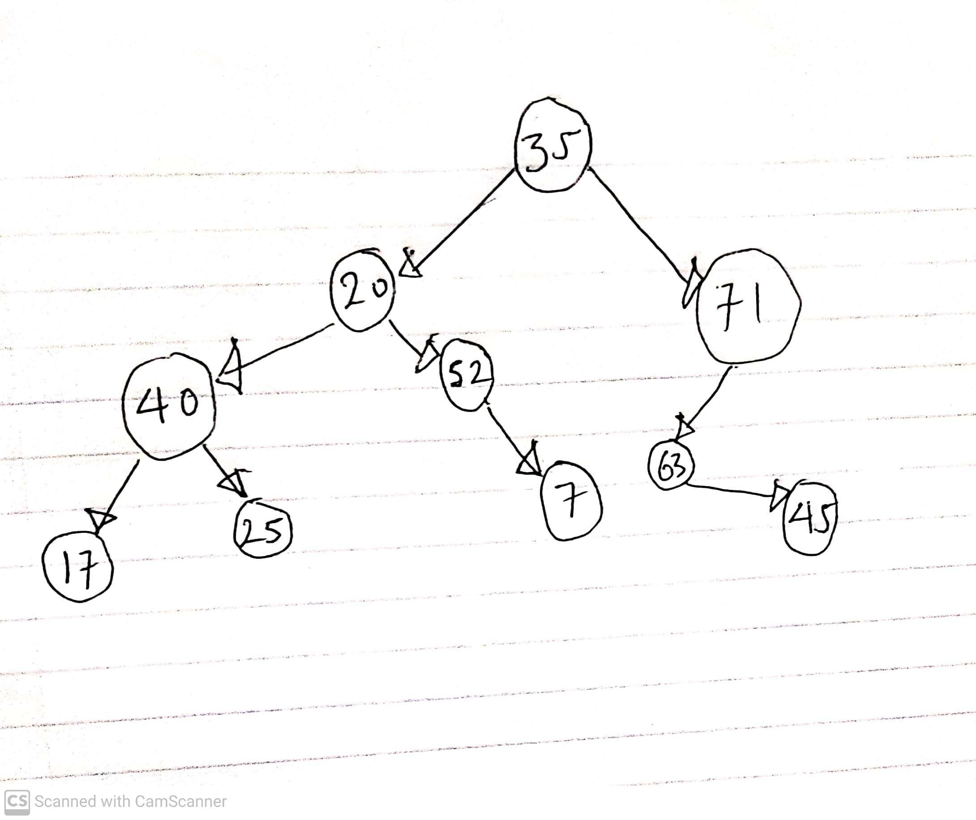
Given the array pictured below, draw the binary tree that can be
created from its elements.
35
20
71
40
52
63
null
17
25
null
7
null
45
[0]
[1]
[2]
[3]
[4]
[5]
[6]
[7]
[8]
[9]
[10]
[11]
[12]

